Slide 1
Lesson objective
Need calculators.
PBiS focus: Empathy
- Accept and understand differences
Title: Topic review
Aim – be able to:
Determine best average to use
Identify spread of data
Plan:
Review shapes
Survey issues
Outliers

Slide 2
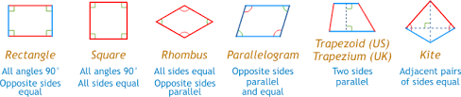
Name that shape!

Slide 3
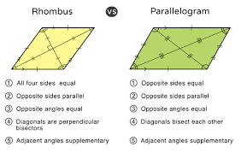
What’s the difference?

Slide 4
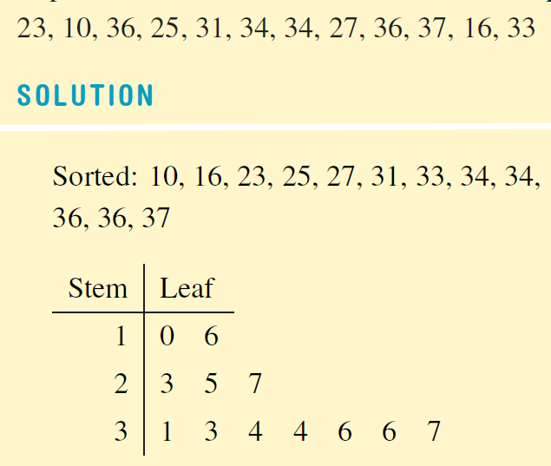
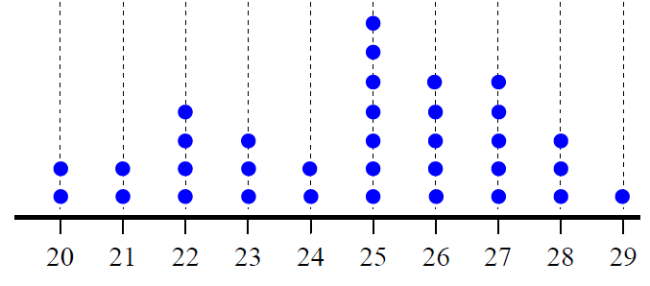
Which graph?
Where there is a large range and few repeats, a Stem and Leaf is more informative.
When the leaves contain one digit each, are put in order, are lined up in a grid, and there is a key, it is a Stem and Leaf diagram.
Where there is a small range and lots of repeats, a Dot Plot is more informative.
When there is a scale at the bottom, and the dots are lined up on the grid, it is a Dot Plot.
10, 36, 23, 31, 25, 33, 16, 34, 27, 34, 37, 36
Scale:
means 23m
25, 28, 23, 24, 23, 24, 27, 26, 25, 25, 22, 22, 20, 29, 25, 26, 27,
26, 28, 21, 25, 25, 27, 21, 25, 27, 26, 27, 22, 26, 23, 20, 22, 28

Slide 5
Which graph?
Where there is a large range and few repeats
A Stem and Leaf is more informative.
Where there is a small range and lots of repeats,
A Dot Plot is more informative.

Slide 6
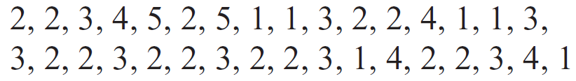
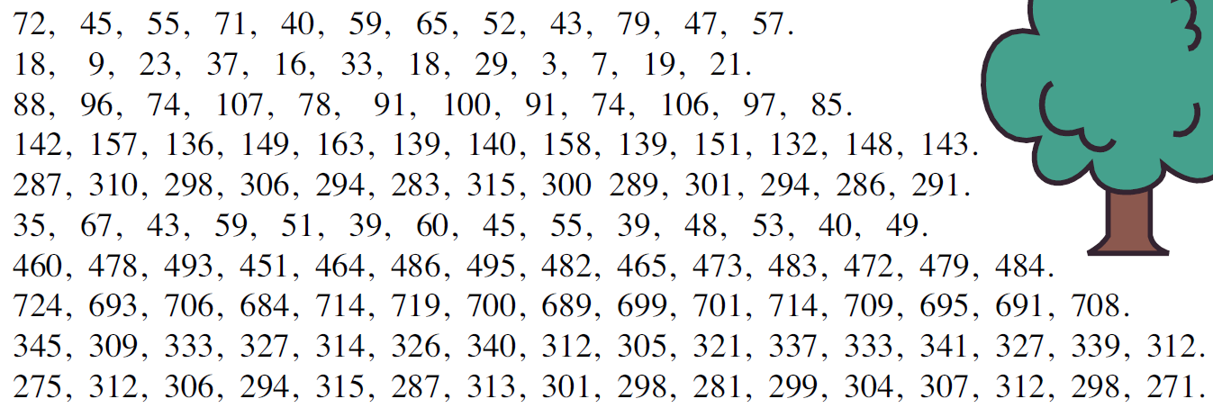
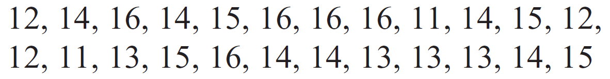
Dot Plot or Stem-and-Leaf?
How many repeats?
Small or large range?

Slide 7
Census Vs. Sample survey
A census records data from everyone in a target population, a sample is a small part of the population.
A census records data from _______ in a target population, a sample is a small part of the population.
A census records data from _______ in a target population, a sample is a ________ of the population.

Slide 8
Issues with census and samples
We want to measure the height of every student in the school… what are some issues we might come across?
Census
Sample survey

Slide 9
Review: outliers
What is an outlier?
What averages does an outlier affect?
If there is an outlier, what is more accurate, mean or median?

Slide 10
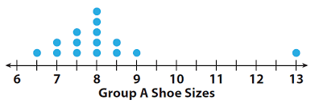
In pairs
Outlier
Mean and median with (person A)
Mean and median without (Person B)

Slide 11
Spread of data
Range of the data
Small range (spread) ➔ more consistent
Large range (spread) ➔ less consistent

Slide 12
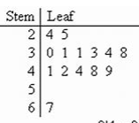
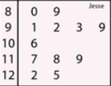
Which has a higher spread?
10 6 = 106
4 2 = 42

Slide 13
Skills check – can you….
Calculate mean, mode, median and range?
Identify outliers and say what they do?
Know how to make a dot plot and a stem and leaf?
Know when do use these?
Identify errors on a graph?
Page 315
Questions 7 – 14
Maths 4 Everyone.com
Ref: G621. 1E1

